Slide 1

FIFA 18 VIZ
Sabin Bhandari
Shikhat Karkee

Slide 2

INTRODUCTION

Slide 3
MOTIVATION
Football visualization is enjoyable
To address visualization difficulties from gamer point of view
To address visualization unavailable in the game
To provide different strategic view with visualization

Slide 4

EXAMPLE OF
PROBLEMS
Unavailable visualization of countries with high rated players or high rated youth.
Unavailable visualization of potentials of youth players

Slide 5

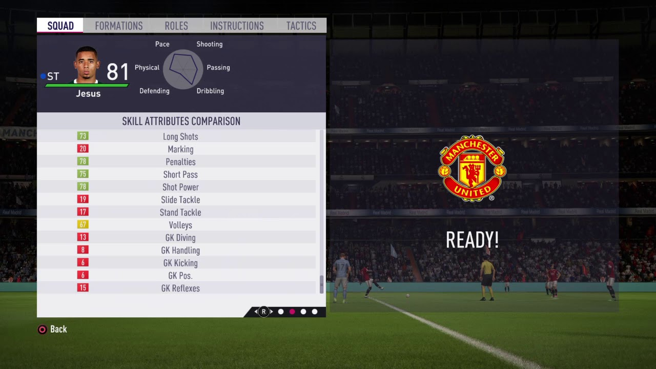
Hard to visualize the polygon.
Harder for human eye to remember the area of the polygon

Slide 6
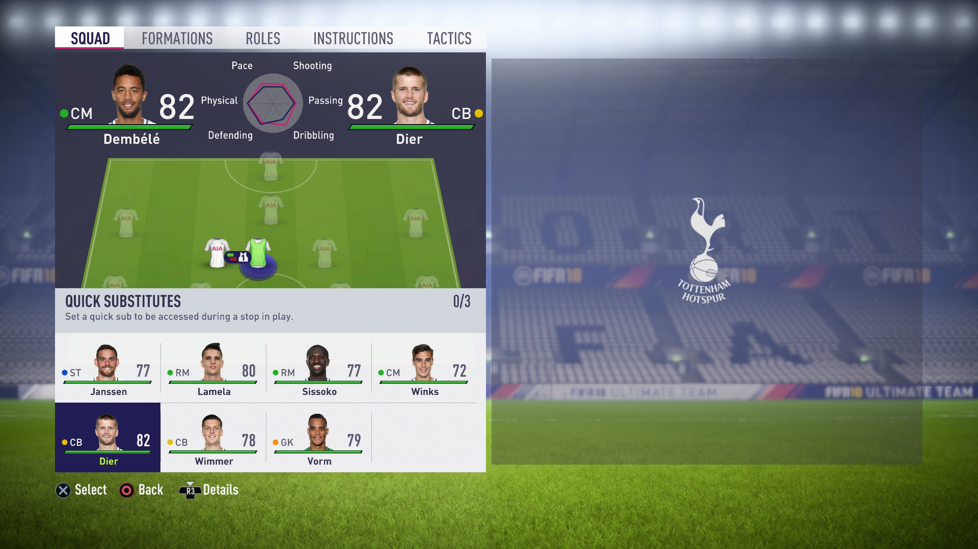
Comparison available only during specific time
Multiple comparison not possible

Slide 7
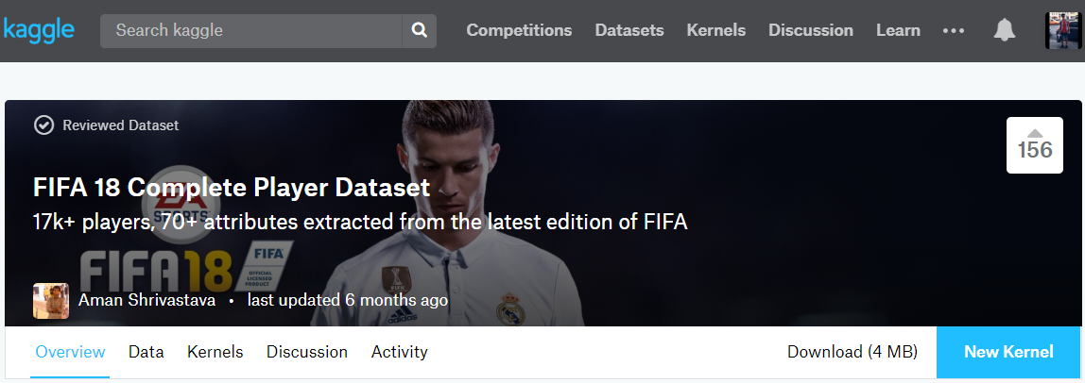
DATASET
Every player featuring in FIFA 18
Based on actual data of EA's FIFA 18 game
70+ attributes with playing position data
Player personal data like Club, Age, Wage, etc.

Slide 8
TOOLS USED
TABLEAU
D3

Slide 9
Desktop Project

Slide 10
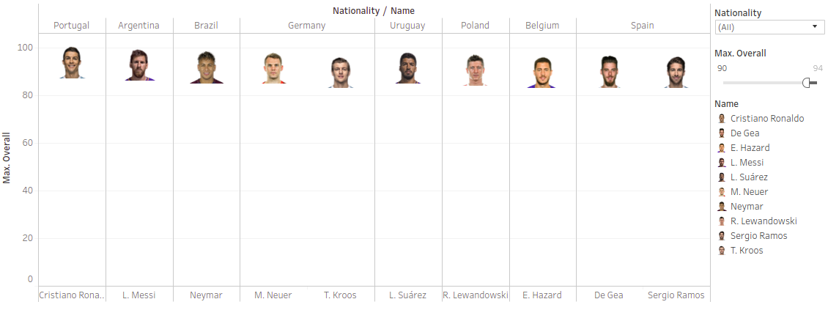
1. Country With Superstars

Slide 11
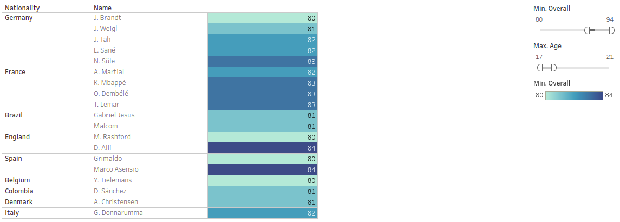
2. Country with Special Youths

Slide 12
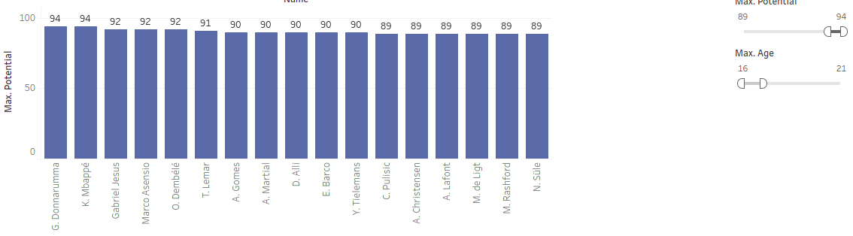
3. Youths with High Potential

Slide 13
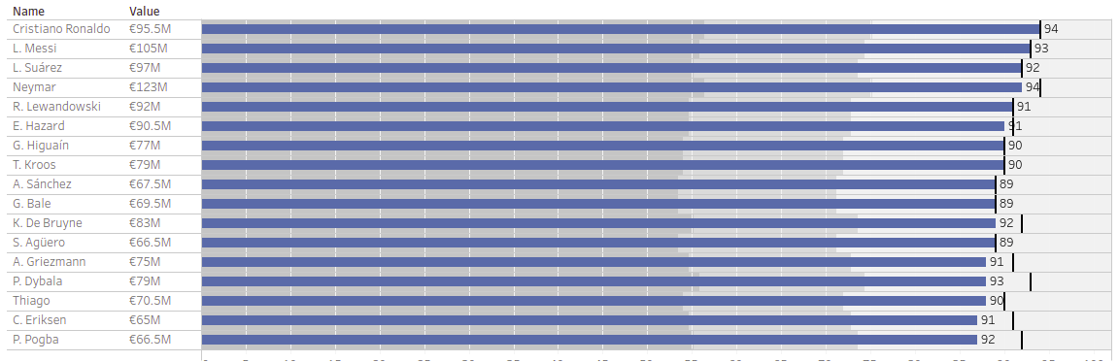
4. Top Values and Potentials

Slide 14
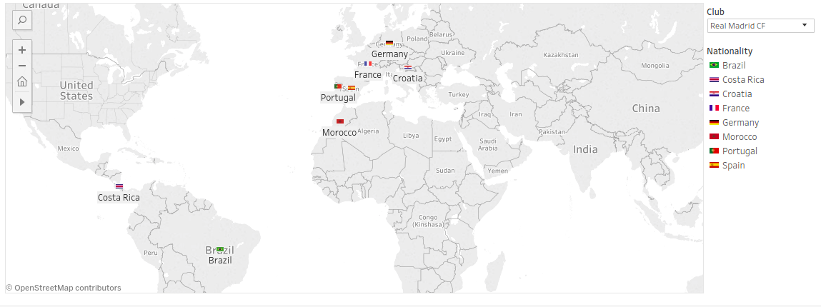
5. Nationality Distribution of Clubs

Slide 15
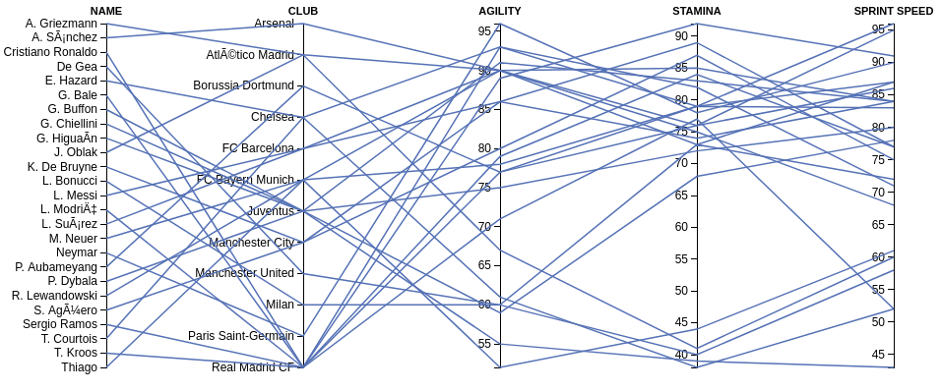
6. Statistics of Top 25 players

Slide 16
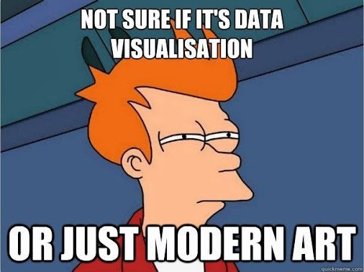
THANK YOU!

